Slide 1

Cdr Vijay Pratap Singh, Adjunct Professor

Slide 2

Process by which an organisation ensures that it has the right number & kind of people at the right place and at the right time, capable of effectively and efficiently completing those tasks that help the organization achieve its overall objectives.

Slide 3
HRP is the process of forecasting an organization's future demand of right type with right number of Human resource.
Based on such planning, the HRM department can initiate the recruitment and selection process.
Its is called manpower planning, personal planning or employment planning

Slide 4
Human resources forecasting involves projecting labour needs and the effects they’ll have on a business.
An HR department forecasts both short and long-term staffing needs based on projected sales, office growth, attrition and other factors that affect a company’s need for labour.
In addition to forecasting the number and type of workers you’ll need, HR planning includes analyzing the various costs and administrative work that go along with adding workers or downsizing.

Slide 5

Human resources forecasting helps you avoid long-term holes in your staffing needs by keeping on top of which of your employees might be retiring, leaving or asked to leave.
HR manager plans to fill these holes with internal staff or prepares for a quick recruiting effort.

Slide 6

In addition to forecasting labor needs, human resources forecasting helps HR to plan budgets based on future staffing levels.
HR manager forecasts the personnel costs each year to undertake budgeting plan.

Slide 7

FUTURE PERSONNEL NEEDS
COPING WITH CHANGE
CREATING HIGHLY TALENTED PERSONNEL
PROTECTION OF WEAKER SECTIONS
INTERNATIONAL STRATEGIES
FOUNDATION FOR PERSONNEL FUNCTIONS
INCREASING INVESTMENTS IN HUMAN RESOURCES
RESISTANCE TO CHANGE AND MOVE

Slide 8
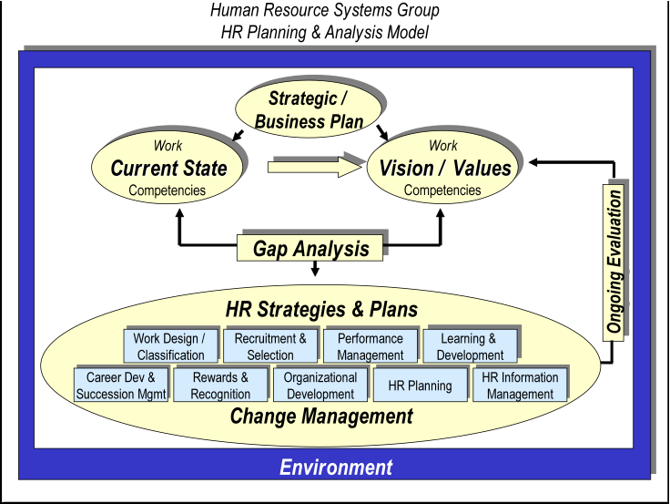
HR Planning strategic model

Slide 9
There are four general steps in the HRP process:
Identifying the current supply of employees
Determining the future of the workforce
Balancing between labor supply and demand
Developing plans that support the company's goals.

Slide 10

Demand forecasting is the process of estimating the future quantity and quality of people required.
The basis of the forecast must be the annual budget and long-term corporate plan, translated into activity levels for each function and department

Slide 11
Demand forecasting must consider several factors both internal and external.
Among external factors are competition(foreign and domestic), economic climate, laws and regulatory bodies, changes in technology and social factors.
Internal factors include budget constraints, production levels, new products and services, organizational structure and employee separation.

Slide 12
Managerial judgement
Ratio-trend analysis
Work study techniques
Delphi technique
Flow models
Other techniques

Slide 13

HR planning and analysis
Equal employment
Staffing
HR development
Compensation and benefits
Health,saftey and security
Employee and labor relations

Slide 14
Assessment of knowledge, skills, abilities, experience and career aspirations of each of current employees.
This record need to be updated at least every 2 years and include changes such as new skills, additional qualifications, changed job duty etc.

Slide 15

A replacement chart is used to estimate vacancies in higher level jobs and identify how potential HR supply can fill these vacancies via internal movements from lower levels jobs.
Generally, a replacement chart includes profile of job holders such as information about employees’ performance, required experience, education, skills and readiness to fill the position.

Slide 16

After personal demand and supply are forecast the vacancies should be filled at right time with right employees.

Slide 17

Converting HR plan into action.
Action programmes are..
    Recruitment
    Selection & placement
    Training and development
    Retraining & redeployment
    The retention plan
    The redundance plan
    The succession plan

Slide 18
It covers no. of trainees required
It necessary for existing staff
Identification of resource personal for conducting development programmes
Frequency of training and development programmes
Budget allocation

Slide 19
Analysis of demand
Audit of existing executives
Planning of individual career path
Career counseling
Accelerated promotions
Performance related training and development
Planned strategic recruitment
Filling the openings

Slide 20

Establish the reporting procedures
Identifying who are in post and those who are in pipe line
It should report employment costs against budget and trends in wastage and employment ratios

Slide 21
People question the importance of making HR practices future oriented and role assigned to HR practitioners in formulation of organizational strategies
HR practitioners are perceived as expert in handling personnel matters, but are not experts in managing business.
HR information often is incompatible with the information used in strategy formulation.
Conflicts may exist between short term and long term HR needs.
Conflicts between quantitative and qualitative approaches to HRP.
Non-involvement of operating managers renders HRP ineffective.

Slide 22


